Slide 1



A web app that educates people about voting and mail-in ballots
Made with love in 24 hours:
Product Design: Melinda Chen, Janavi Chadha
Dev: Sarah Wahelie, Atishaye Jain, Ted Wang

Slide 2

Problem
Currently only about 51% of eligible voters in the United States actually vote during major elections and even less vote in their local elections. Due to COVID-19 we may see an even smaller voter turnout due to concerns about social distancing. While mail-in ballots are an option, most voters aren’t familiar with the process and therefore may choose not to vote.

Slide 3
How might we
How might we design website for voters to navigate the voting process and registration for social distanced people?

Slide 4

Persona - Grace
Grace is a 19 year old girl studying at NYU. She isn’t really involved in politics and this is the first time she could vote. She is scared about COVID and don’t want to go where there are a lot of people
Frustrations
She is impatient about researching and wants to get it done quick
Desires
She wants to vote and make an impact in her district

Slide 5
As-Is Scenario for Grace
Act ( Feeling )
1:Grace sees an ad for upcoming election, realize she has to vote. ( Anxious )
2: She goes on online to find out more about the election, candidates and deadline ( Confused )
3: She finally determines which candidates to vote for ( Relief )
4. Doesn’t want to go in person due to COVID ( Scared )
5. Researches again for how to vote online in her state ( Annoyed )
6. Realizes that she had to request a mail-in ballot at least two weeks before election and she missed the voting period ( Mad )

Slide 6
Main Painpoints
Unaware of smaller upcoming local elections
Impatient about the multiple registration process
No knowledge of the voting process

Slide 7
To-Be Scenario for Grace
Act (Feeling)
1: Grace sees an ad for upcoming election, realize she has to vote. ( Anxious )
2: Through a friend she found out about VoteOn.online ( Excited )
3: She enters her zip code and the website and receives a list of elections, candidates their standpoints and deadlines ( Happy )
4. She determines who to votes for and applies for mail in ballot( Relief )
5. Once the mail-in ballot arrives she fills it out and sends it back having successfully voted for the first time ( Joy )

Slide 8

Solution
VoteOn provides its users a single solution to their voting questions and problems.
Though VoteOn users can find their upcoming local / state / federal elections, information on the candidates as well as resources on how to register to vote and how to request for mail in ballots on a state by state basis.

Slide 9
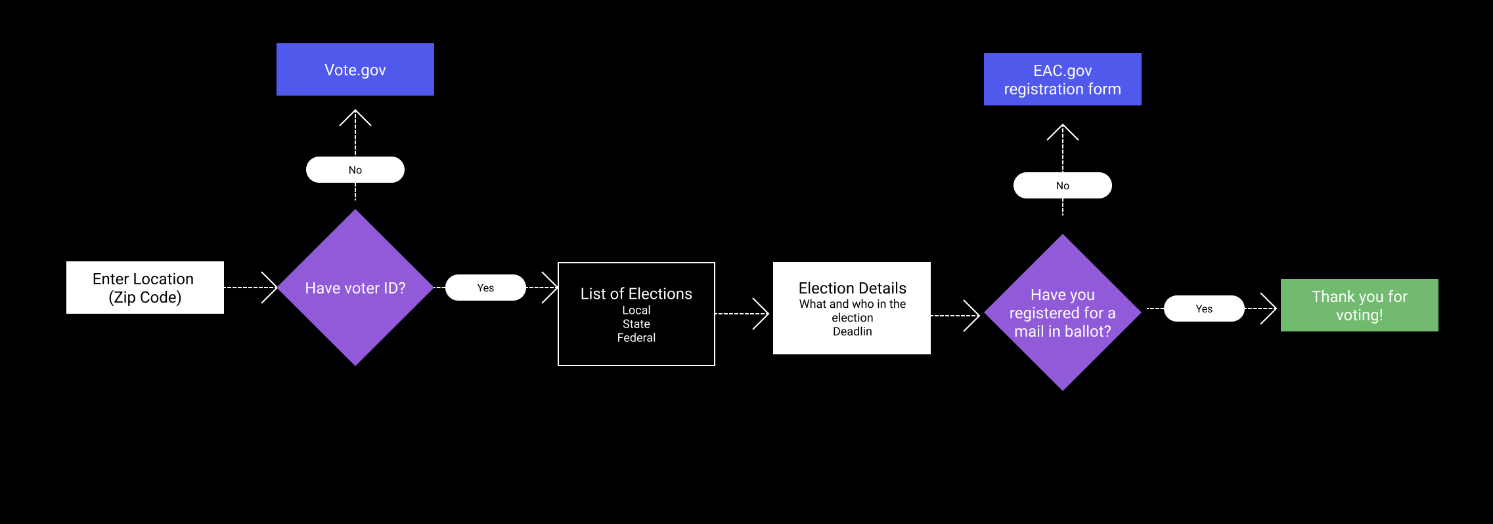
Flowchart

Slide 10
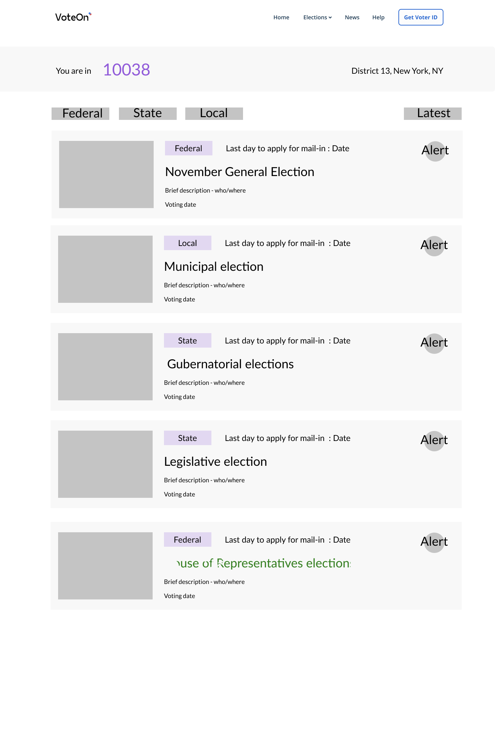
Process

Slide 11
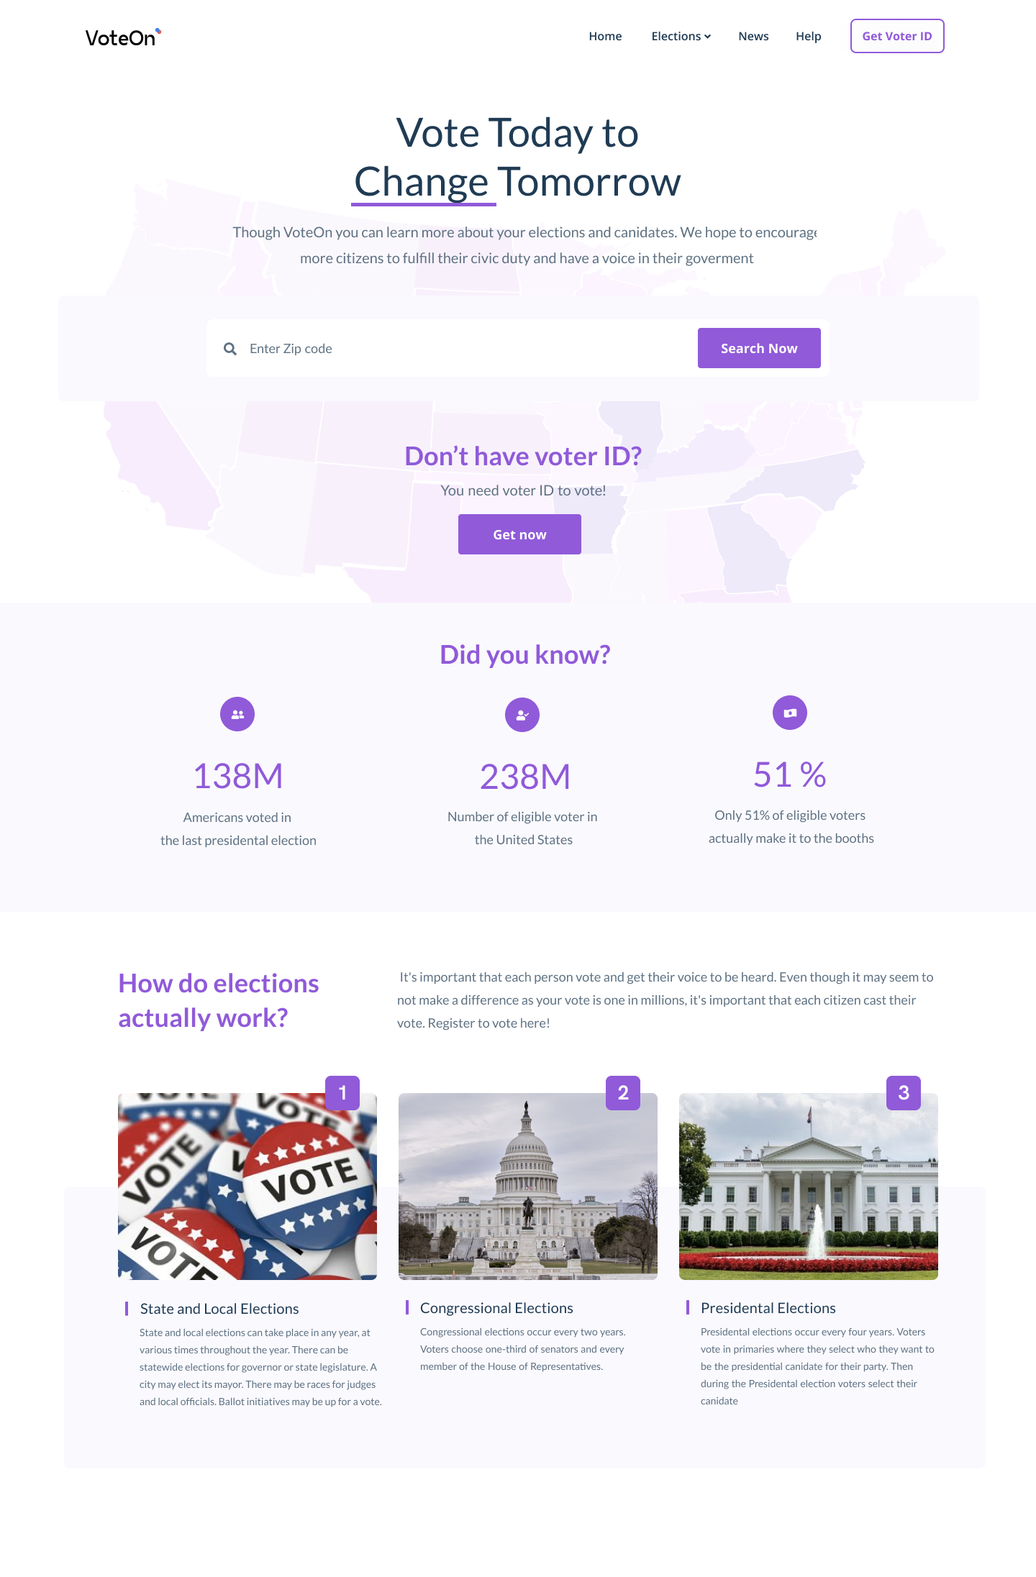
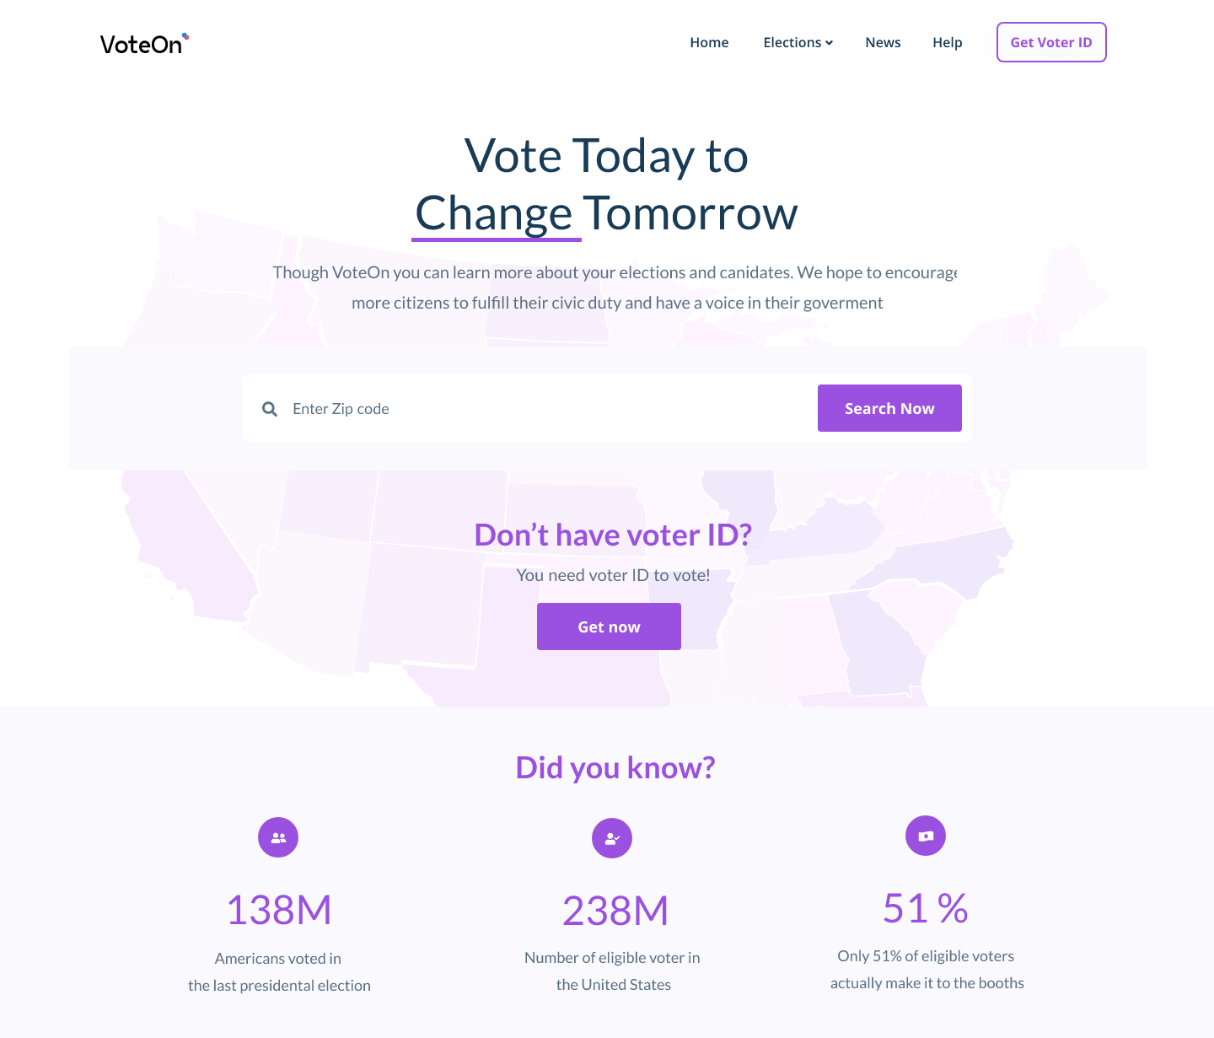
Final Design Home Page
Voter enters zip code
CTA to get voter ID
Fun facts about elections

Slide 12
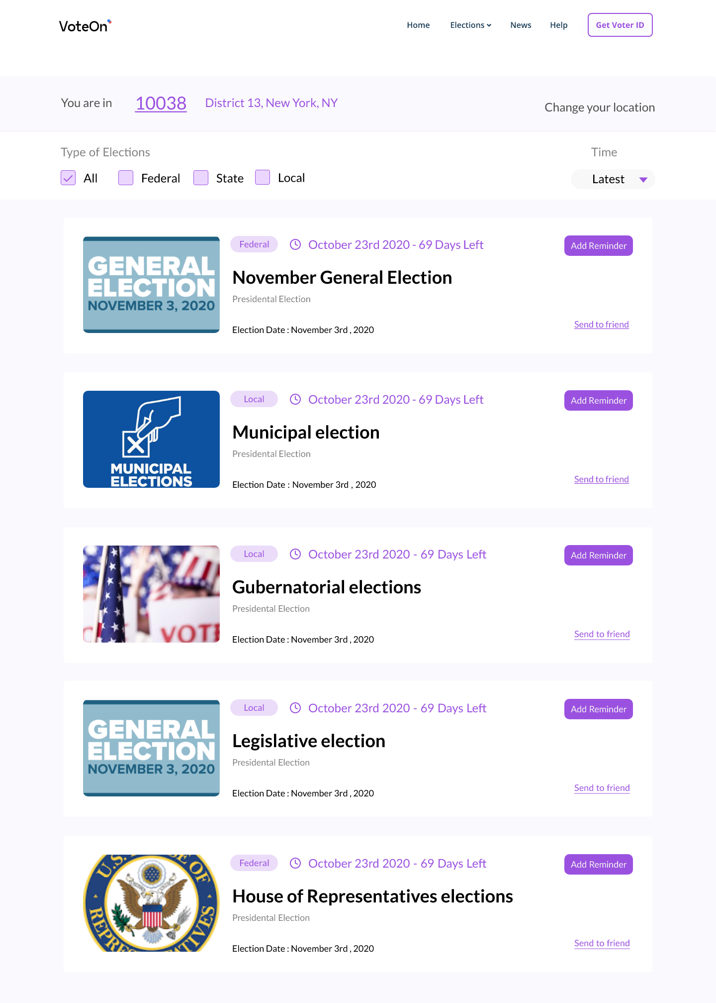
Final Design Election Page
Filter by type and time
Voter can add email and SMS reminders for upcoming elections
Deadline for mail in ballot already calculated
Send link to friends

Slide 13
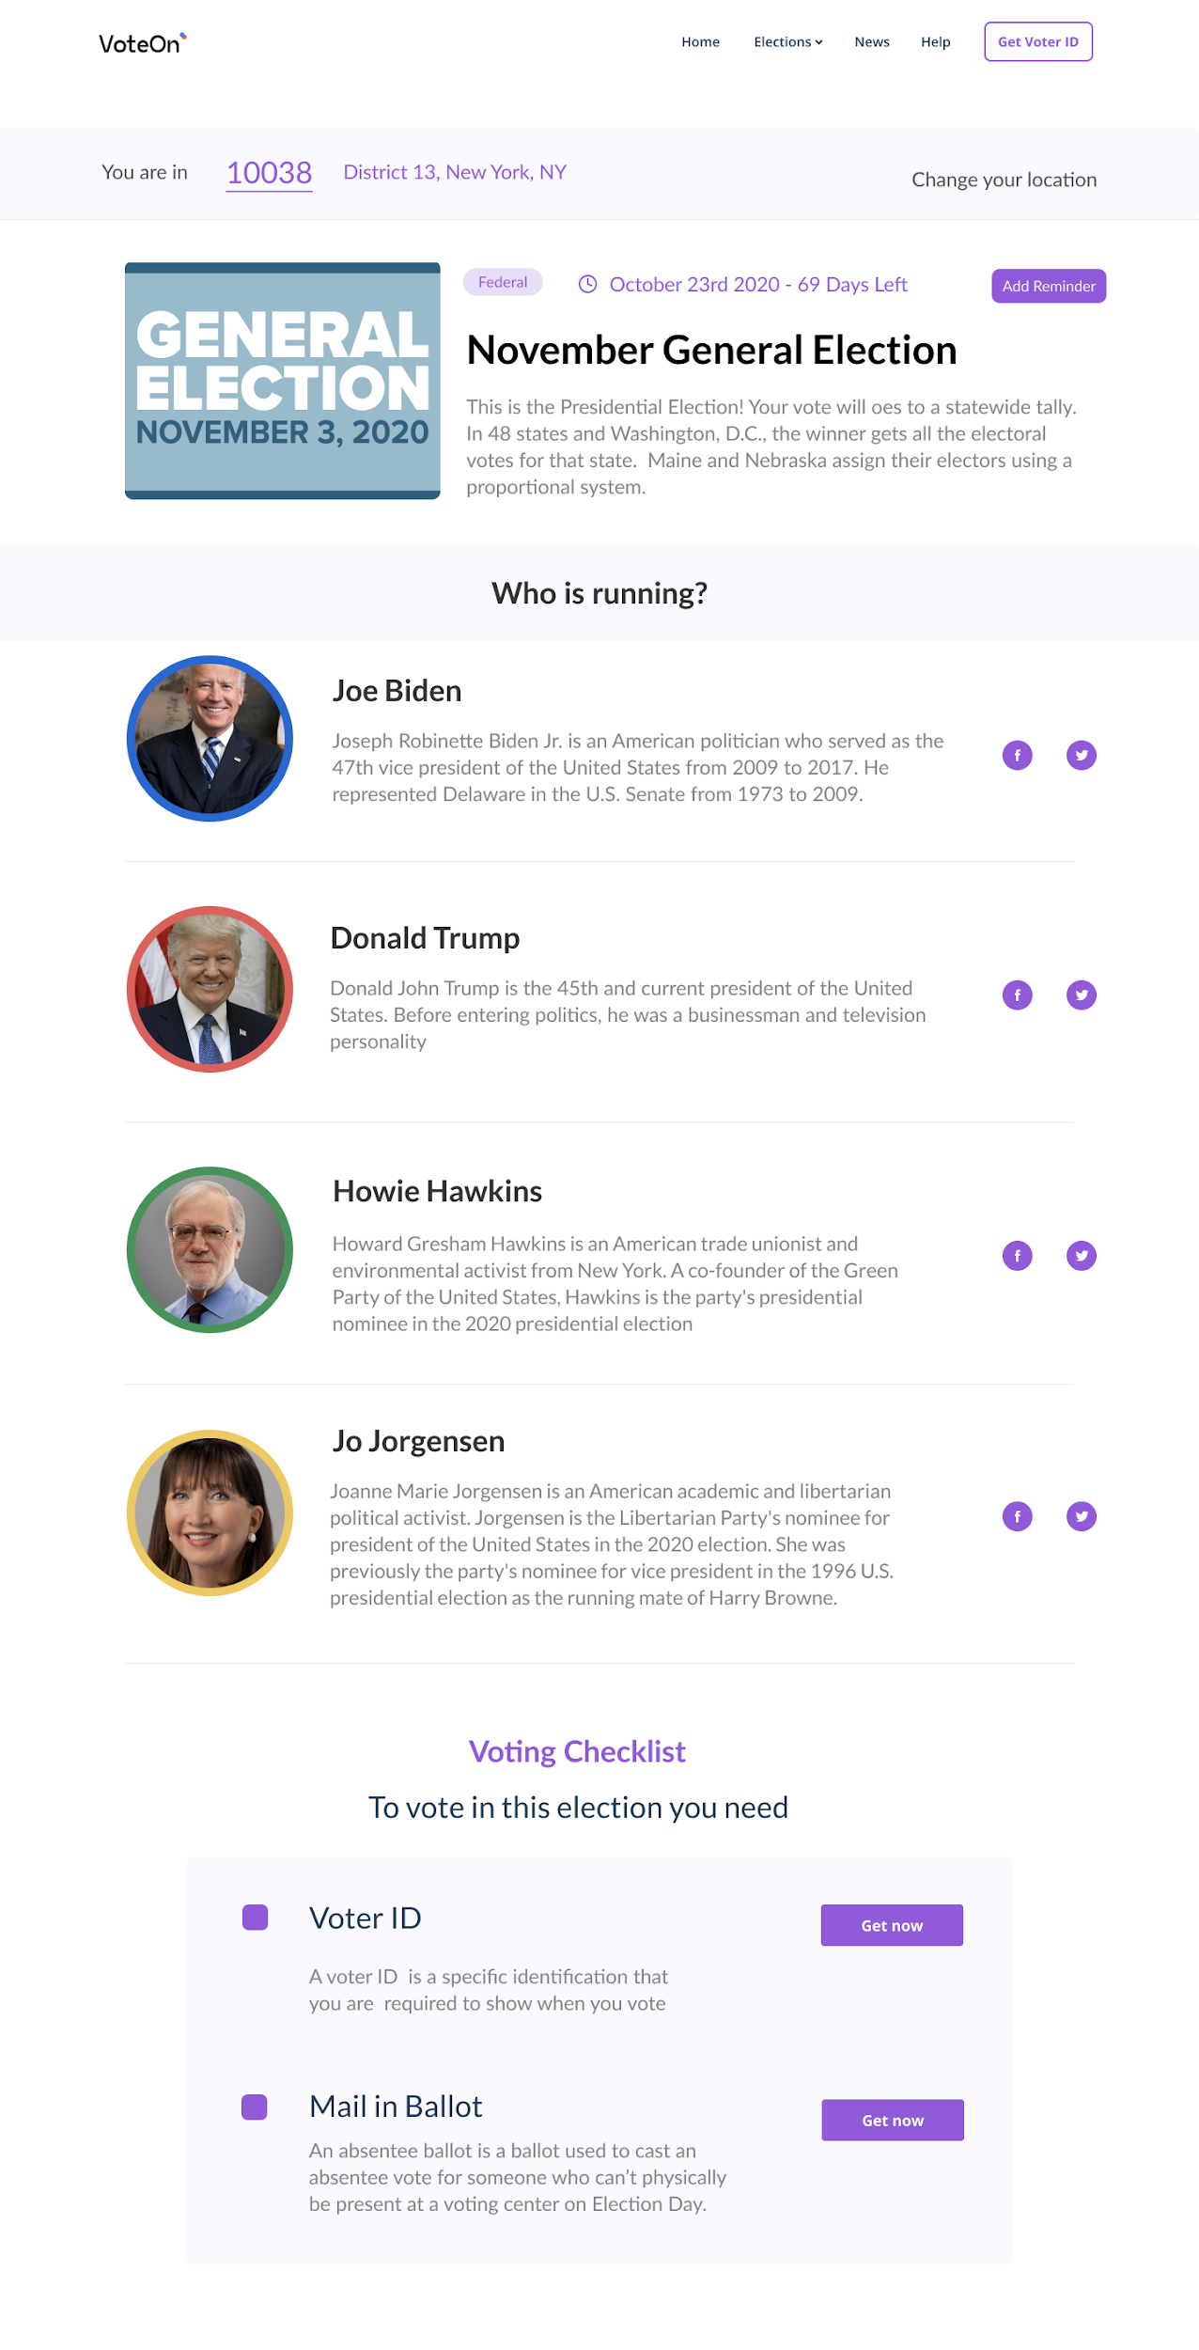
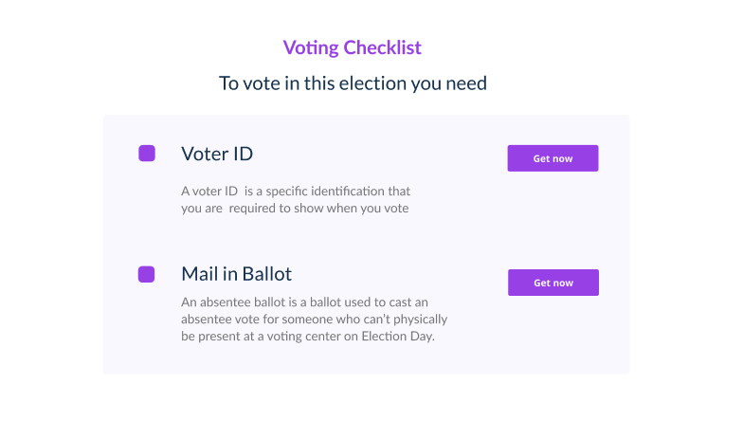
Final Design Election Details Page
Voter can see details about election
Voter can register for voter ID card
Voter can register for mail in ballot

Slide 14
Work in process - website link

Slide 15
VoteOn
Thank you!

